Slide 1


Slide 2






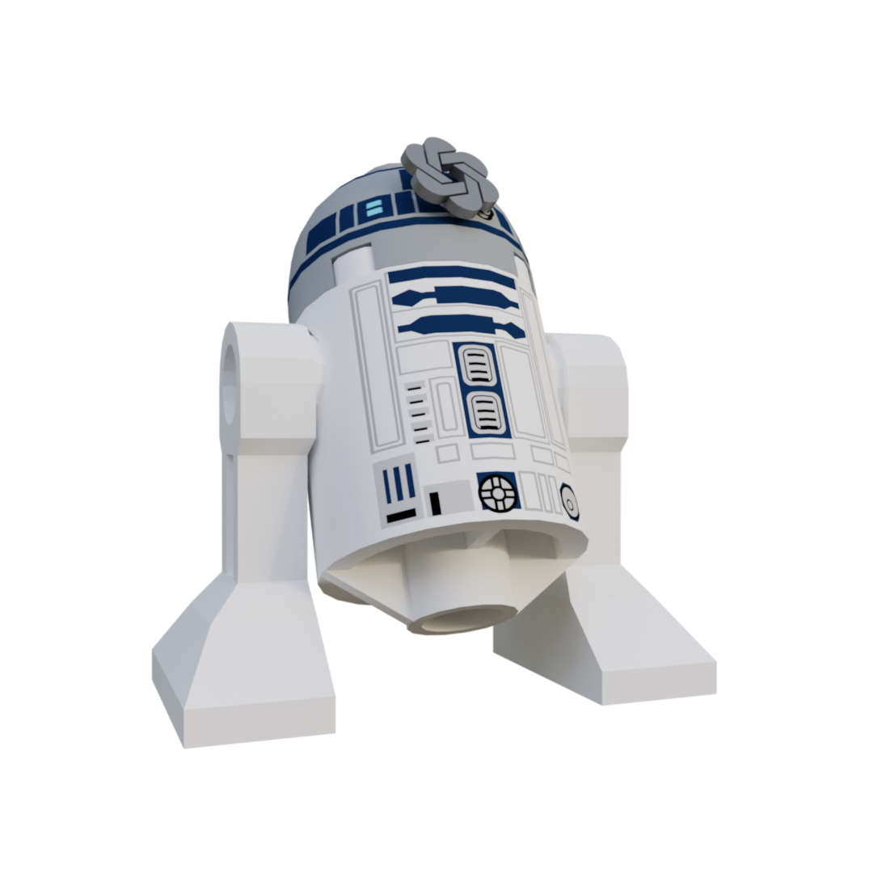
Performance Troubleshooting for Developers

Slide 3

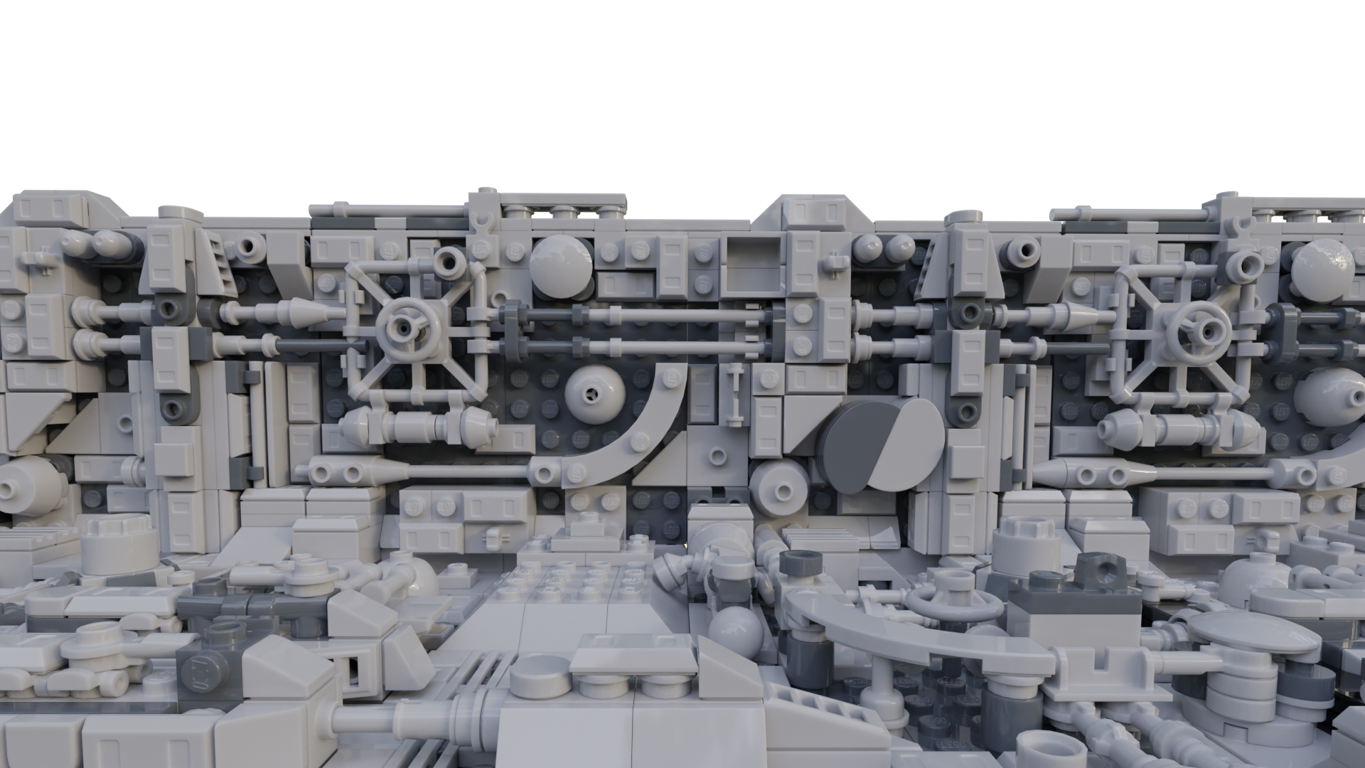





Slide 4



Speaker
Nathan Clouse
Technical Architect
Microsoft MVP 5x
Armanino AtomicAX.com Dynamics.fo

Slide 5


Performance
Why are things slow?
Can I speed things up?
How can I do that?

Slide 6
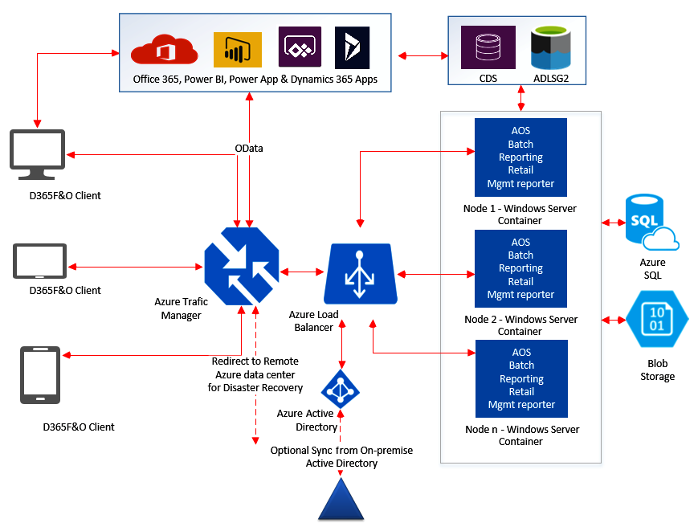
Architecture

Slide 7
Common Problems
Poor Indexing
Poor Loop architectures
Not using Batch processing
Not using indexes
Not creating indexes

Slide 8
Identifying Common Problems
Symptoms of performance degradation
“Its slow”
Where? When? In what legal entity? For which process?
Collect a trace for the process plus a recording to repro
Differentiating between code-level and database-level issues
Is opening a form slow?
Or is clicking on a specific button taking a long time?

Slide 9
Code – Bad Pattern - Insert
for(int i = 0; i <= this.parmRecordCount(); i++)
{
ttsbegin;
SalesPool.SalesPoolId = int2Str(i);
SalesPool.Name = int2Str(i);
SalesPool.insert();
ttscommit;
}

Slide 10
Code – Good Pattern - Insert
ttsbegin;
for(int i = 0; i <= this.parmRecordCount(); i++)
{
SalesPool.SalesPoolId = int2Str(i);
SalesPool.Name = int2Str(i);
SalesPool.insert();
}
ttscommit;

Slide 11
Code – Better Pattern - Insert
RecordInsertList SalesPoolList;
SalesPoolList = new RecordInsertList(tableNum(SalesPool));
SalesPool SalesPool;
ttsbegin;
for(int i = 0; i <= this.parmRecordCount(); i++)
{
SalesPool.SalesPoolId = int2Str(i);
SalesPool.Name = int2Str(i);
SalesPoolList.add(SalesPool);
}
SalesPoolList.insertDatabase();
ttscommit;

Slide 12

Code – Best Pattern - Insert
SalesPool SalesPool;
var insertObject = new SysDaInsertObject(SalesPool);
insertObject.fields()
.add(fieldStr(SalesPool, SalesPoolId))
.add(fieldStr(SalesPool, Name));
tmpSalesPool source;
var qe = new SysDaQueryObject(source);
var s1 = qe.projection()
.Add(fieldStr(tmpSalesPool, SalesPoolId))
.Add(fieldStr(tmpSalesPool, Name));
insertObject.query(qe);
var insertStmt = new SysDaInsertStatement();
this.startTimer();
ttsbegin;
insertStmt.executeQuery(insertObject);
ttscommit;

Slide 13
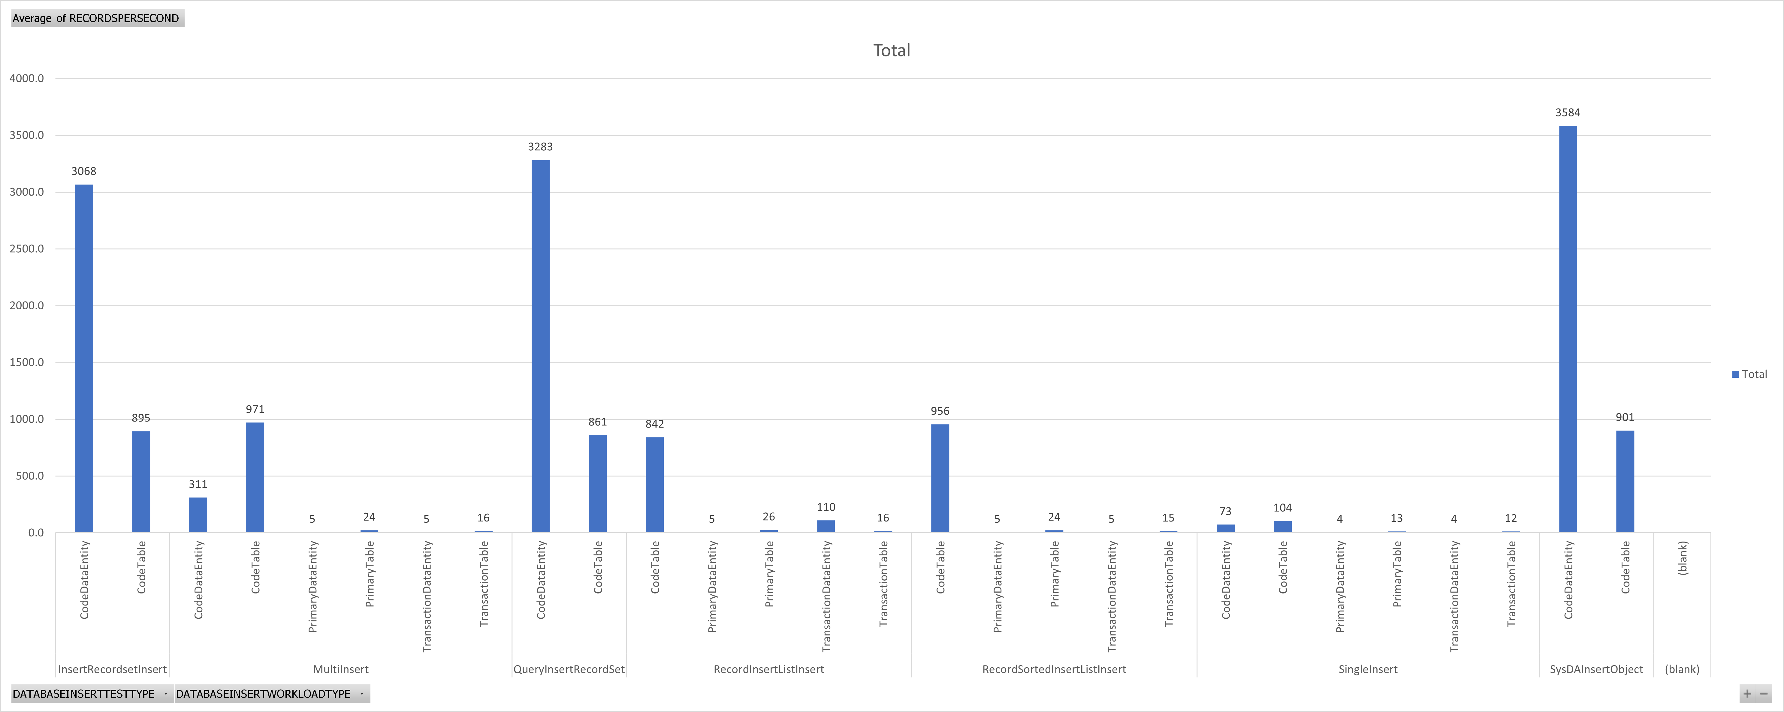
Select Into
Select Into
Best
Better
Good
Worst

Slide 14
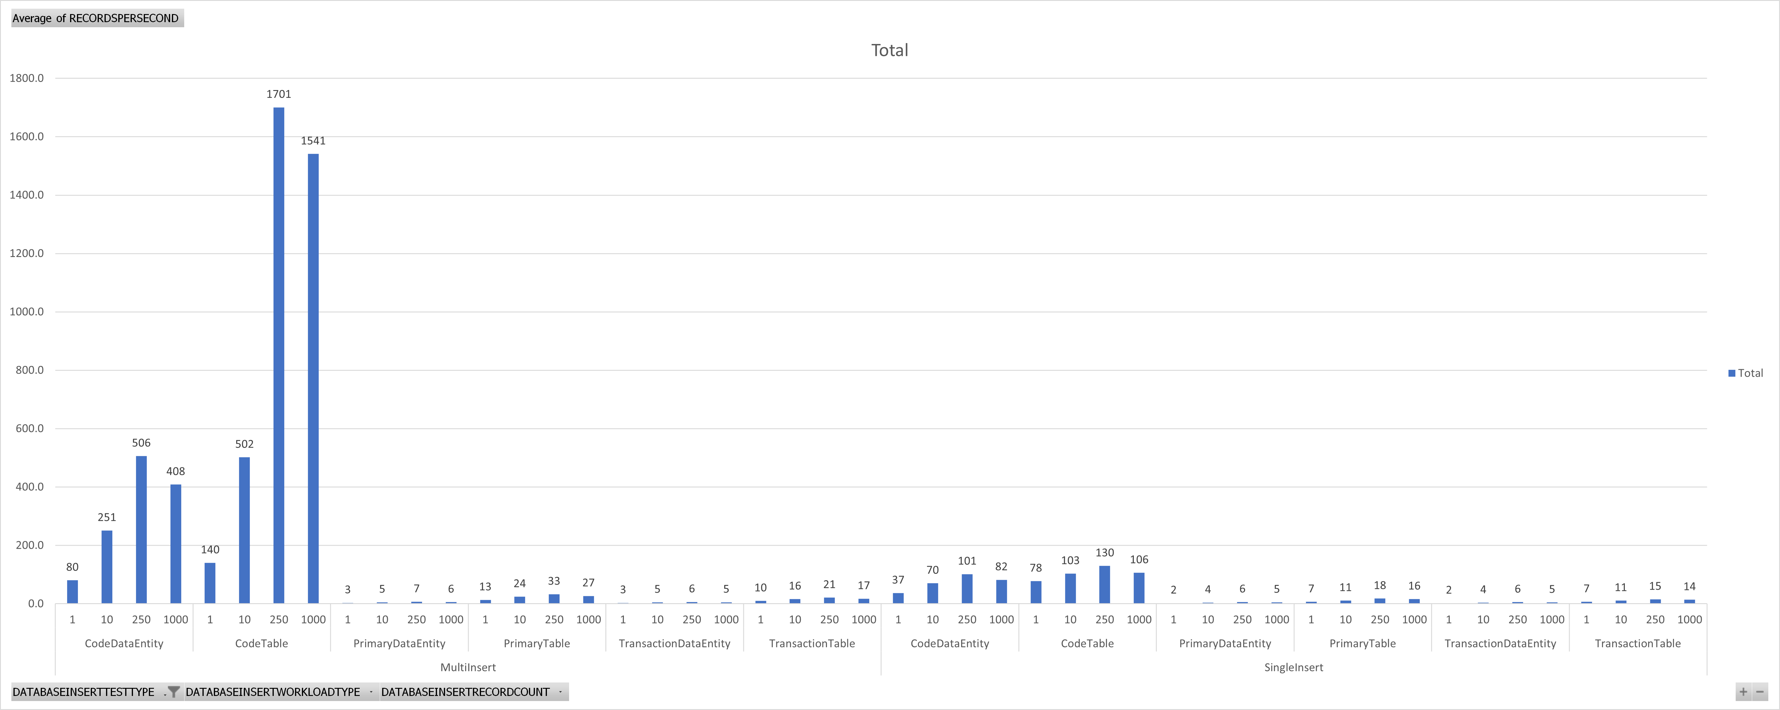
Good
Worst

Slide 15
Code – Bad Pattern - Update
while select forupdate * from SalesPool
{
ttsbegin;
SalesPool.Name = int2Str(new Random().nextInt());
SalesPool.Update();
ttscommit;
}

Slide 16
Code – Good Pattern - Update
ttsbegin;
while select forupdate * from SalesPool
{
SalesPool.Name = int2Str(new Random().nextInt());
SalesPool.Update();
}
ttscommit;

Slide 17
Code – Better Pattern - Update
ttsbegin;
update_recordset CustTable
setting CreditMax = new Random().nextInt()
where CustTable.CreditMax == someValue;
ttscommit;

Slide 18
Code – Best Pattern - Update
var updateObject = new SysDaUpdateObject(CustTable);
updateObject.settingClause()
.add(fieldStr(CustTable, CreditMax), new SysDaValueExpression(new Random().nextInt()));
updateObject.whereClause(
new SysDaEqualsExpression(
new SysDaFieldExpression(CustTable, fieldStr(CustTable, CreditMax)),
new SysDaValueExpression(sentinel)
)
);
var updateStmt = new SysDaUpdateStatement();
ttsbegin;
updateStmt.update(updateObject);
ttscommit;

Slide 19
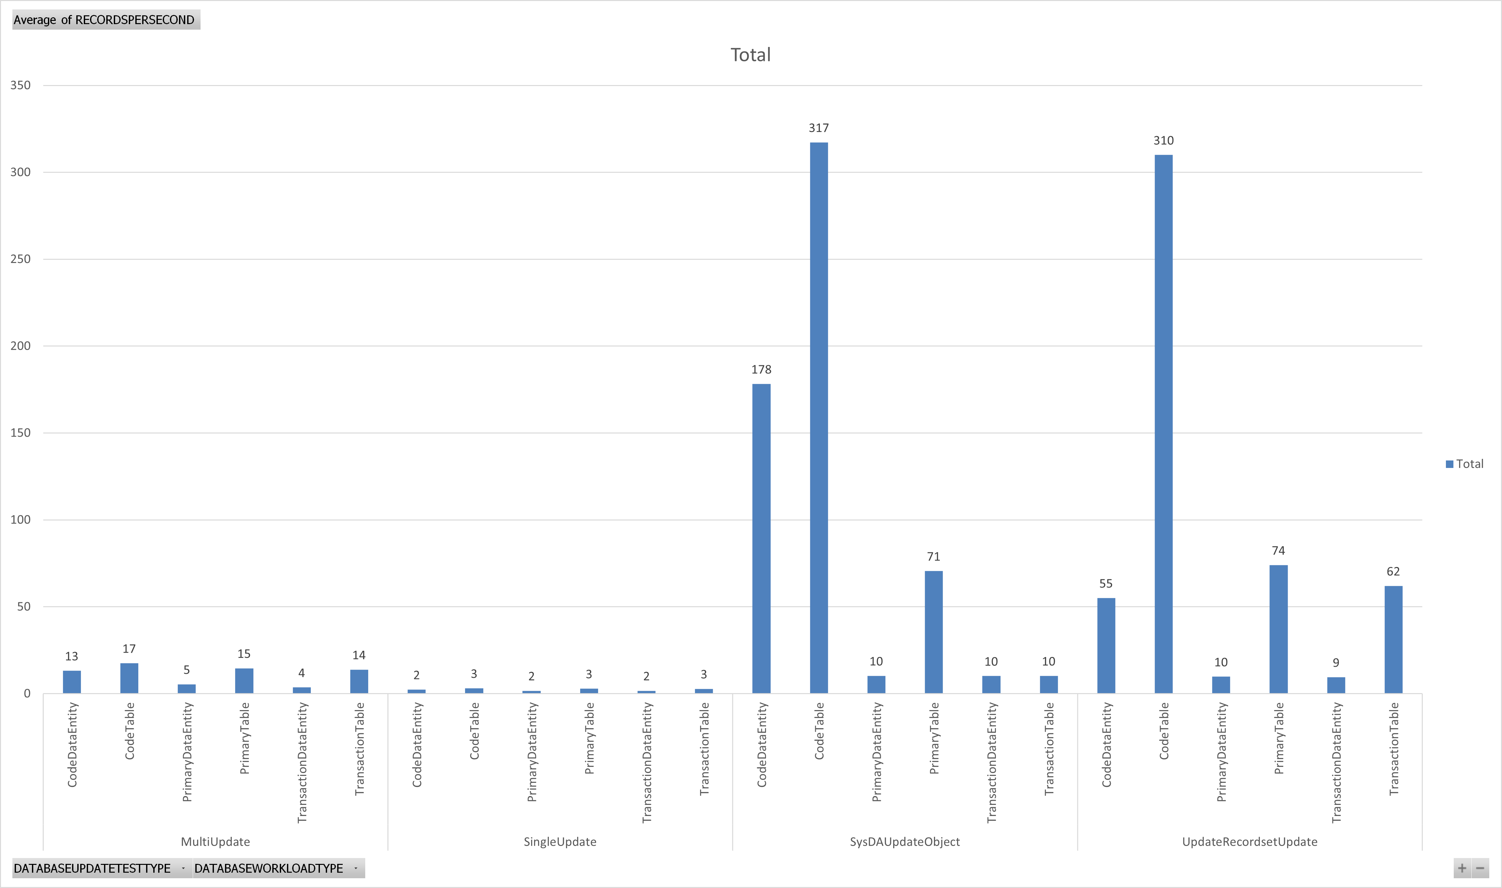
Best
Better
Good
Worst

Slide 20
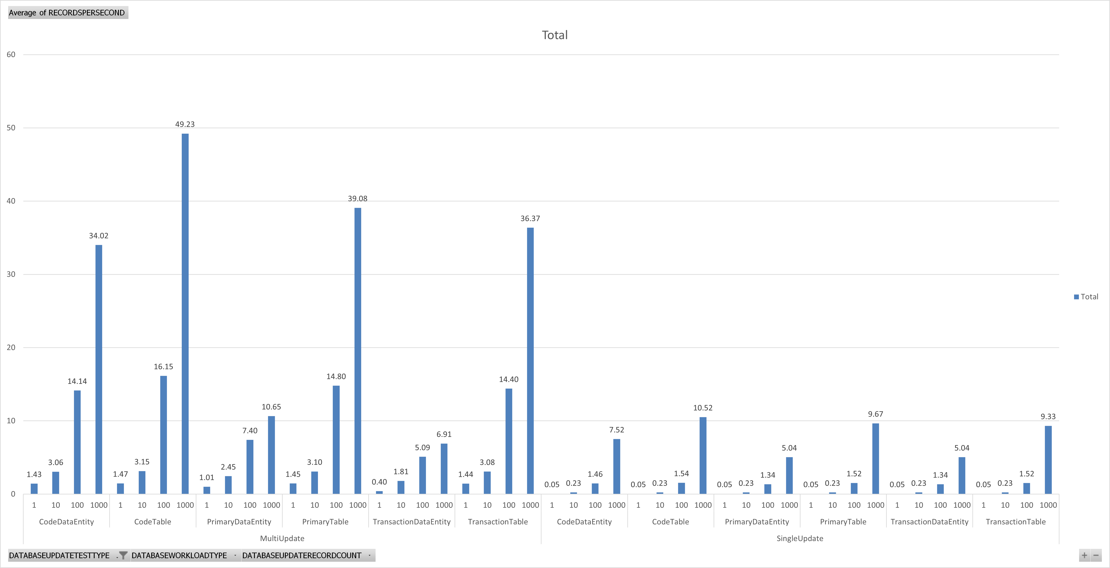
Good
Worst

Slide 21
Does specifying columns matter?
Yes
select firstonly AccountNum from CustTable;
select firstonly PaymTermId, LineDisc, PartyCountry, AccountNum, AccountStatement, BankAccount, Blocked, CashDisc, CashDisc, ClearingPeriod from CustTable;
select firstonly * from CustTable;
Notes:
https://www.atomicax.com/article/database-inserts-and-performance

Slide 22
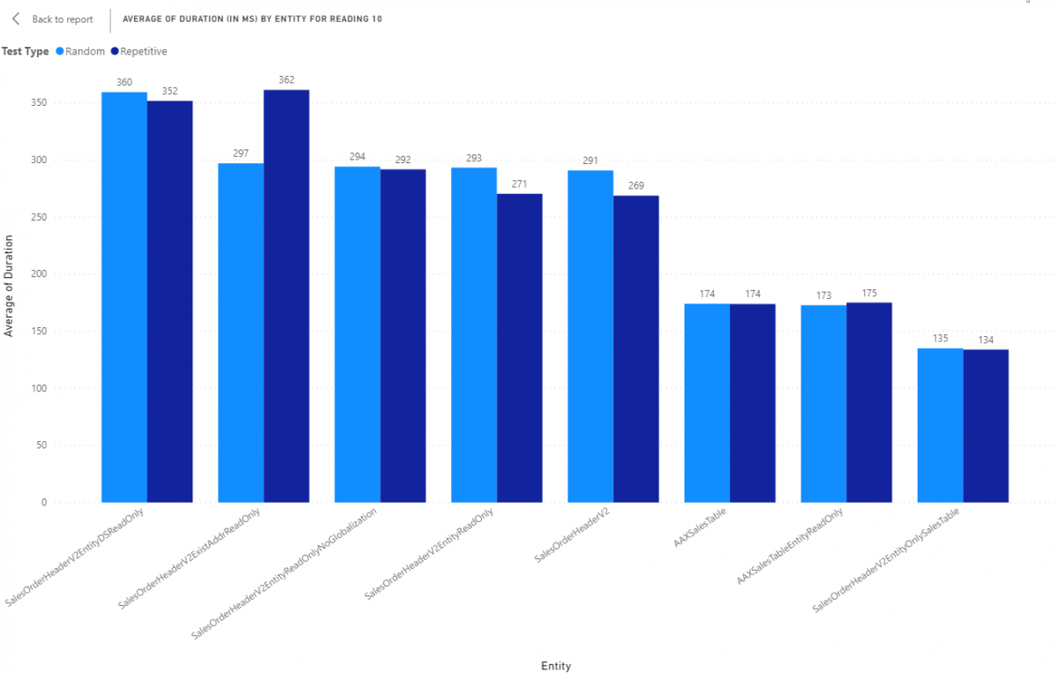
Data Entities

Slide 24
ForceSelectOrder and ForceNestedLoop
select generateonly firstonly forceselectorder forcenestedloop * from salesTable
join salesLine
where salesTable.SalesId == salesLine.SalesId;

Slide 25
ForceSelectOrder and ForceNestedLoop
SELECT TOP 1 [fields]
FROM salestable T1
CROSS JOIN salesline T2
WHERE ( ( T1.partition = 5637144576 )
AND ( T1.dataareaid = N'usmf' ) )
AND ( ( ( T2.partition = 5637144576 )
AND ( T2.dataareaid = N'usmf' ) )
AND ( T1.salesid = T2.salesid ) )
OPTION(loop JOIN, force ORDER)

Slide 26
Query Optimization - Bad
while select * from custTable
{
while select * from custTrans
where custTrans.AccountNum == custTable.AccountNum
{
info(strFmt("Transaction: %1 on %2", custTrans.InvoiceId, custTrans.TransDate));
}
}

Slide 27
Query Optimization - Good
while select AccountNum, Name, custTrans.InvoiceId, custTrans.TransDate
from custTable
join custTrans
where custTrans.AccountNum == custTable.AccountNum
{
info(strFmt("Customer: %1, %2 - Transaction: %3 on %4",
custTable.AccountNum, custTable.Name, custTrans.InvoiceId, custTrans.TransDate));
}

Slide 28
Query Optimization - Good
qbdsCustTable = query.addDataSource(tableNum(CustTable));
qbdsCustTable.addRange(fieldNum(CustTable, AccountNum)).value(queryValue("1000"));
qbdsCustTrans = qbdsCustTable.addDataSource(tableNum(CustTrans));
qbdsCustTrans.relations(true);
qbdsCustTrans.joinMode(JoinMode::InnerJoin);
qbdsCustTrans.addRange(fieldNum(CustTrans, TransDate)).value(queryValue(systemDateGet() - 30));

Slide 29
Database General Advice
Ask the database for data as needed but ask for everything you may need upfront
Opening/Closing transactions is the slowest part of any operation (typically)
Only ask for what is needed
Use Set Operations even if “downgrades” will happen
Downgrade means convert from set to row based operation
If a table has a insert(), update(), or delete() on it, this will result in a downgrade

Slide 30
“downgrades”
Situation | delete_from | update_recordset | insert_recordset | RecordSortedList, RecordInsertList | Used to override
Non-SQL tables | Yes | Yes | Yes | Yes | Not applicable
Delete actions | Yes | No | No | No | skipDeleteActions
The database log is enabled. | Yes | Yes | Yes | No | skipDatabaseLog
Overridden method | Yes | Yes | Yes | Yes | skipDataMethods
Alerts are set up for the table. | Yes | Yes | Yes | No | skipEvents
The ValidTimeStateFieldType property on a table is set to a value other than None. | Yes | Yes | Yes | Yes | Not applicable
Notes:
https://learn.microsoft.com/en-us/dynamics365/fin-ops-core/dev-itpro/dev-ref/xpp-data/xpp-data-perf

Slide 31
Troubleshooting
Task Recording
Include Word Doc, Developer recording, and .axtr
Include the legal entity/company, date and time of day with time zone
Use Teams to record your screen if you can ( have a meeting with yourself )

Slide 32
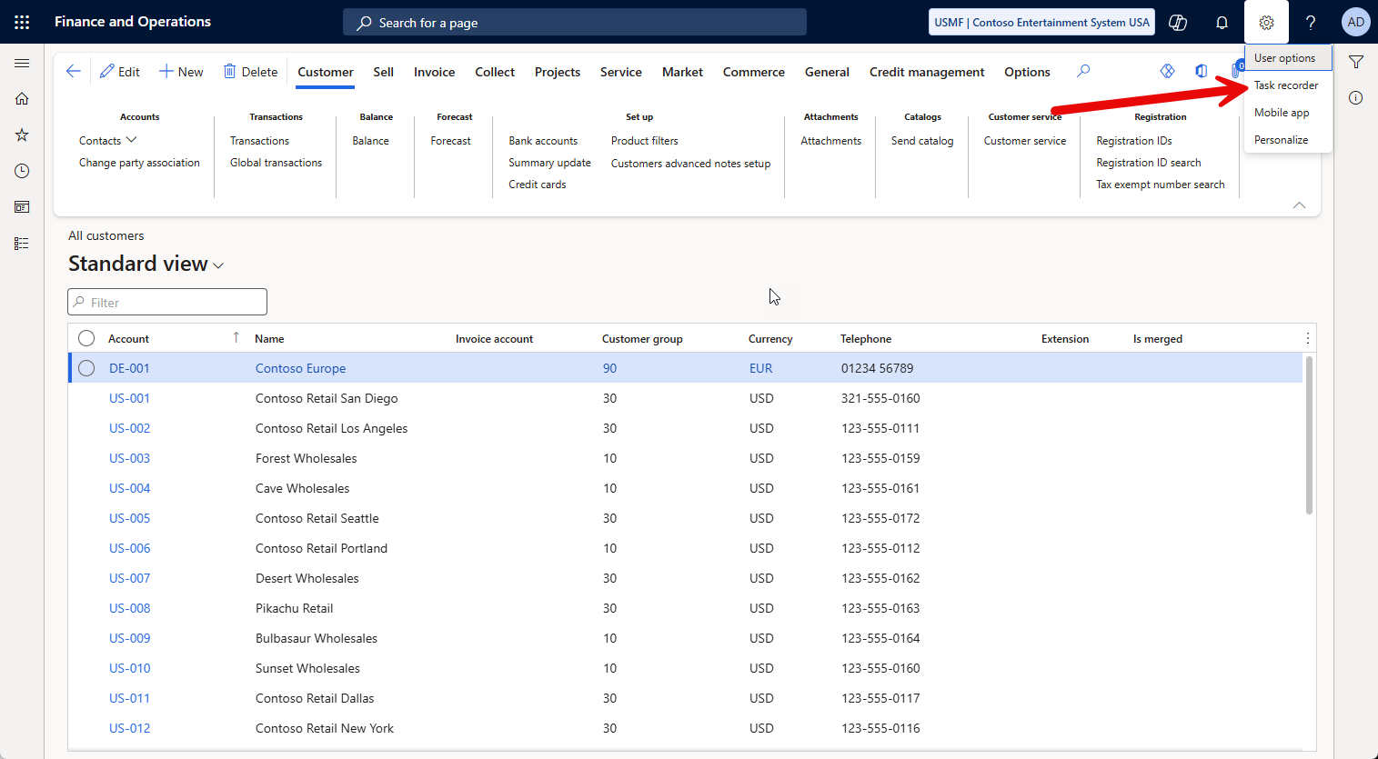

Slide 33
Trace Parser
What is a trace?
Detailed log of events, system calls, SQL queries, and resource usage captured while a specific task is being executed
Help > Trace

Slide 34
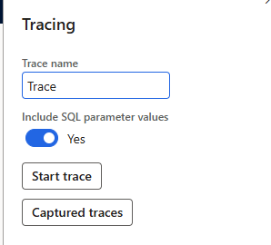
Trace Parser
SQL Parameters
Gives more insight, “costs” a little more when on
Only admins can see previous traces
Users need “System Tracing user” to capture a trace

Slide 35
Parsing A Trace
Found on VHD and VMs.
“Microsoft Dynamics 365 Unified Operations - Trace Parser” in start menu
In UDE assets

Slide 36
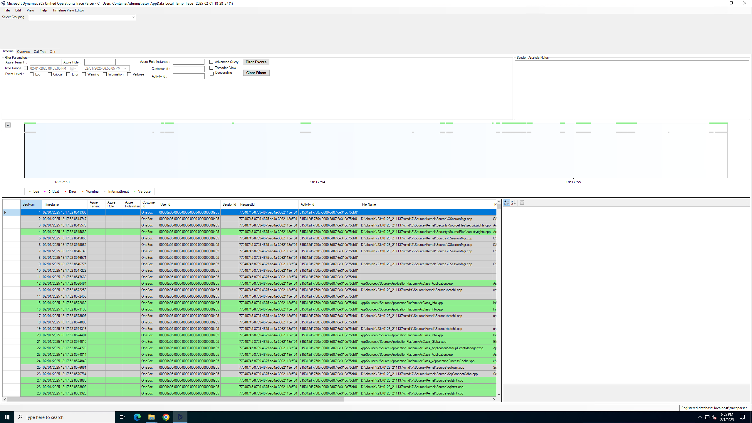

Slide 37
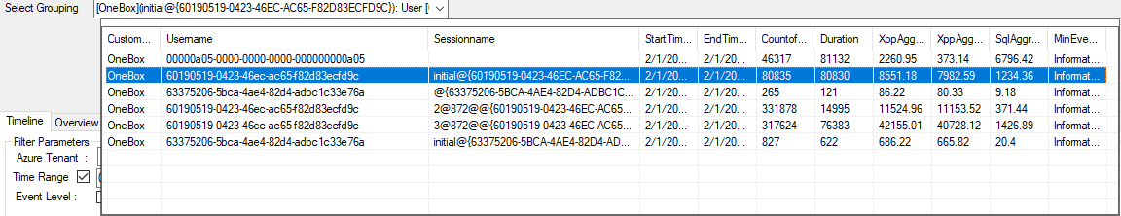

Slide 38
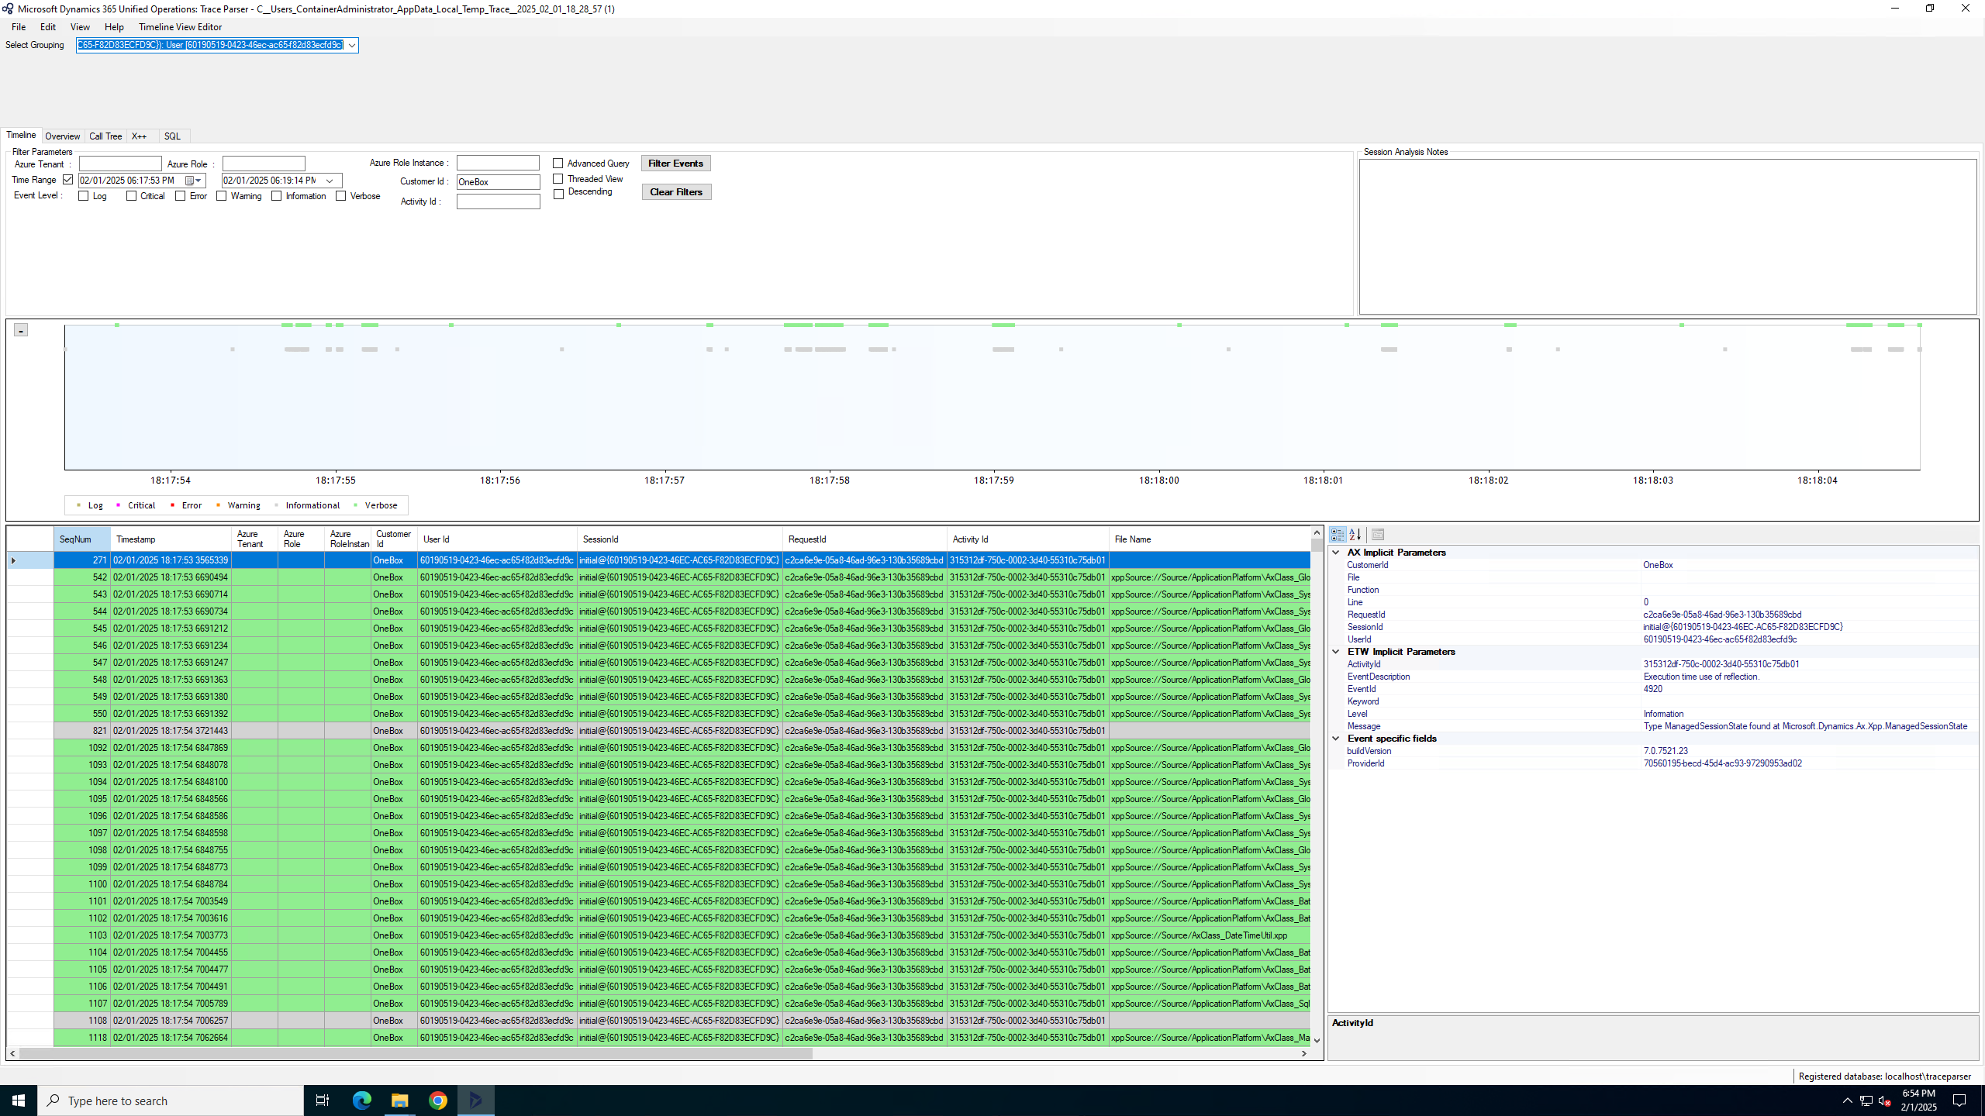

Slide 39
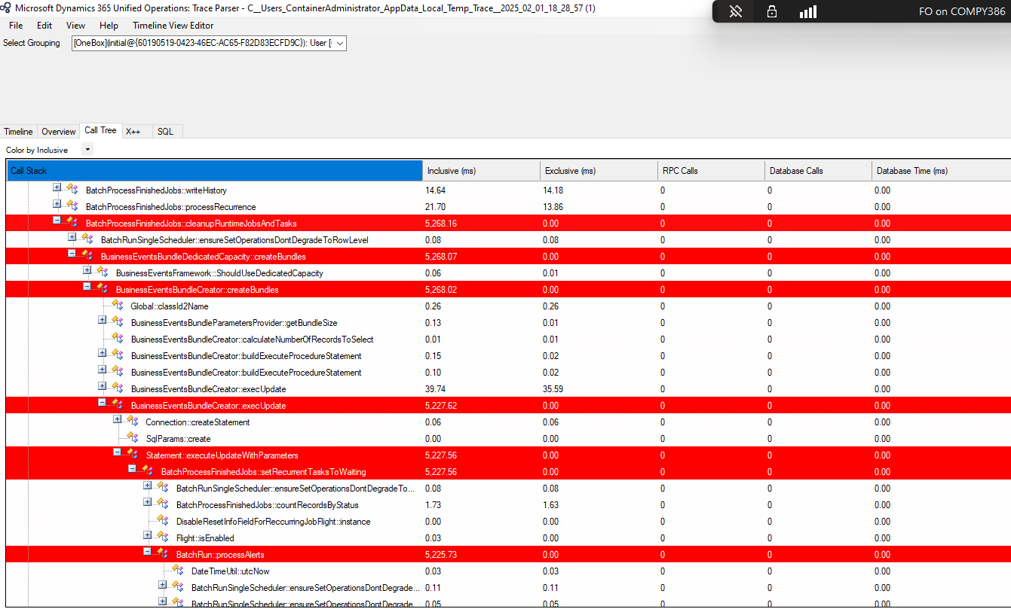

Slide 40
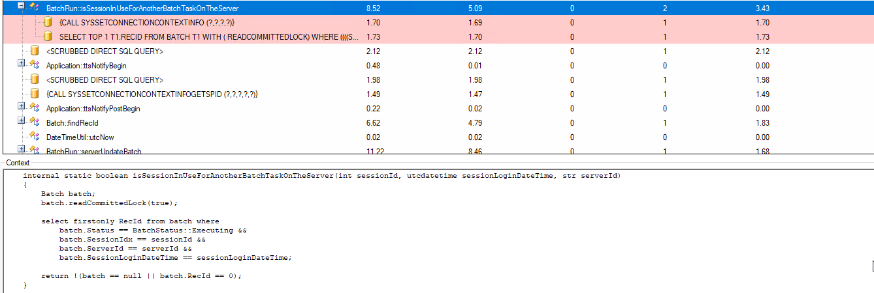

Slide 41
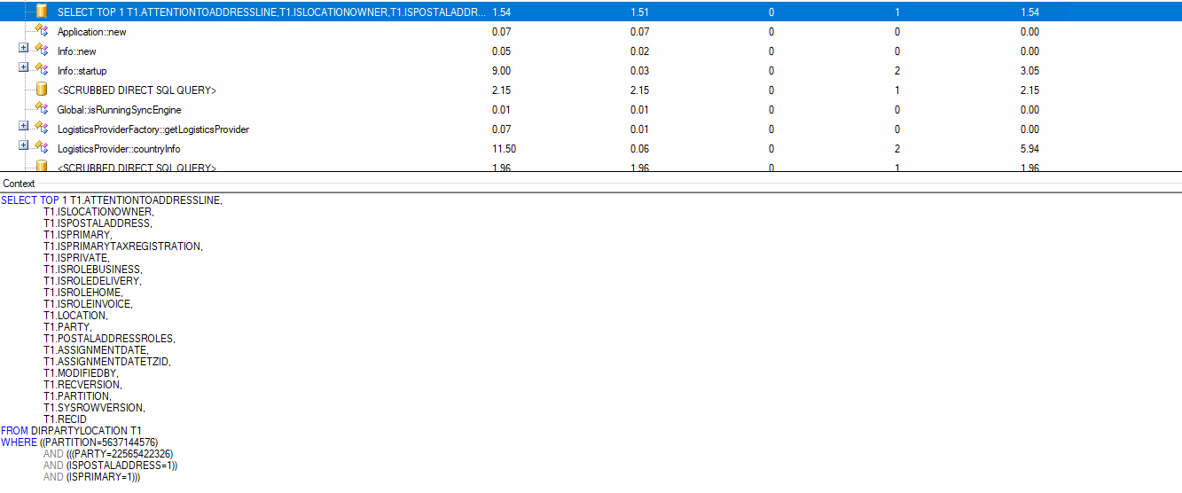

Slide 42
Socratex and XQuery
Can query against code (oversimplified)
Can be used to identify nested loops or other performance related patterns
XQuery can query your code like

Slide 43
Batch Jobs
Microsoft is released new versions of batch jobs
If something is slow, a new feature may be available

Slide 44
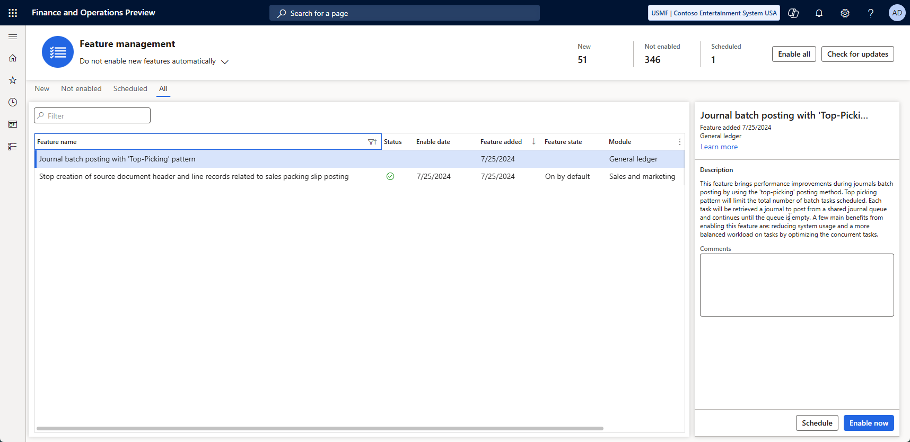

Slide 45
Custom Batch Jobs
“Classic” Batch Job
Individual Task Model
Batch-Bundle
Top-Picking
Each type has pros and cons

Slide 46
Custom Batch Jobs
Classic batch job
Slow but cheap
Single Threaded
Tried-and-True method that works
Individual Task Model
Fast but expensive
“all threaded”
Schedule everything and let batch sort it out

Slide 47
Custom Batch Jobs
Batch-Bundle
Moderate to Fast with some cost
Groups of tasks
Groups get completed 1 group at a time with multiple groups running at a time
Top-Picking
Fast with some temporal cost
“x threaded”
Setup x number of threads / lanes to execute all the work

Slide 48
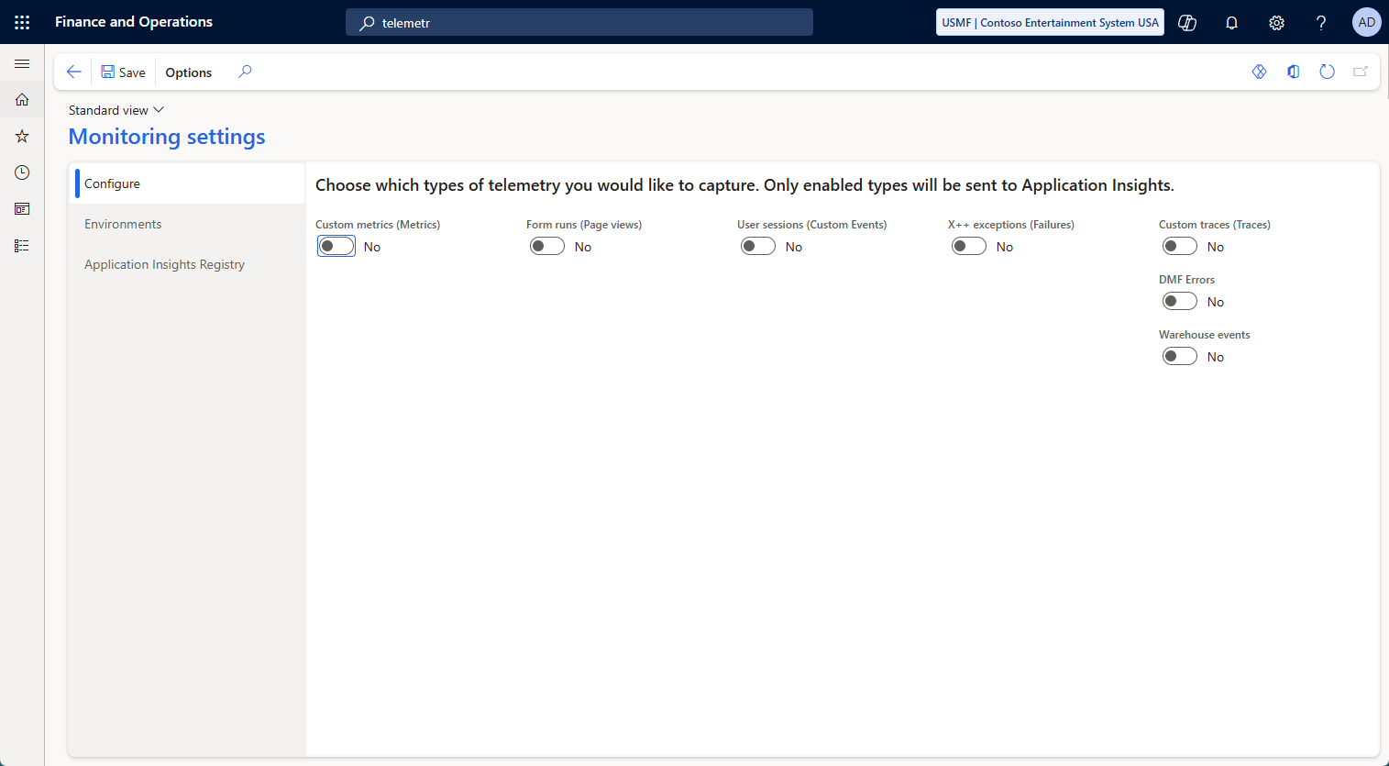
Telemetry
Turn on telemetry
Custom Metrics
Form runs ( Page Views)
User Sessions
X++ exceptions
Custom Traces
DMF Errors
Warehouse events
Add your own

Slide 49
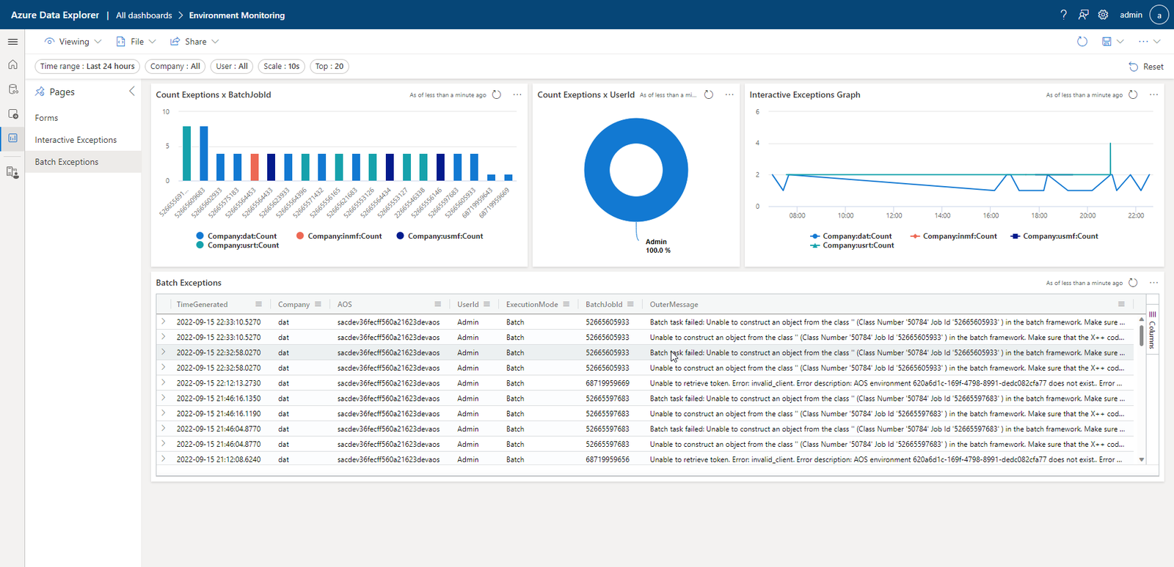
Notes:
Credit: https://samuelardilacarreno.com/2022/09/17/monitoring-and-telemetry-for-dynamics-365-finance-and-operations/

Slide 50
LCS
Limited insight
Reducing functionality over time
No automation available for most logging functionality
Slow

Slide 51
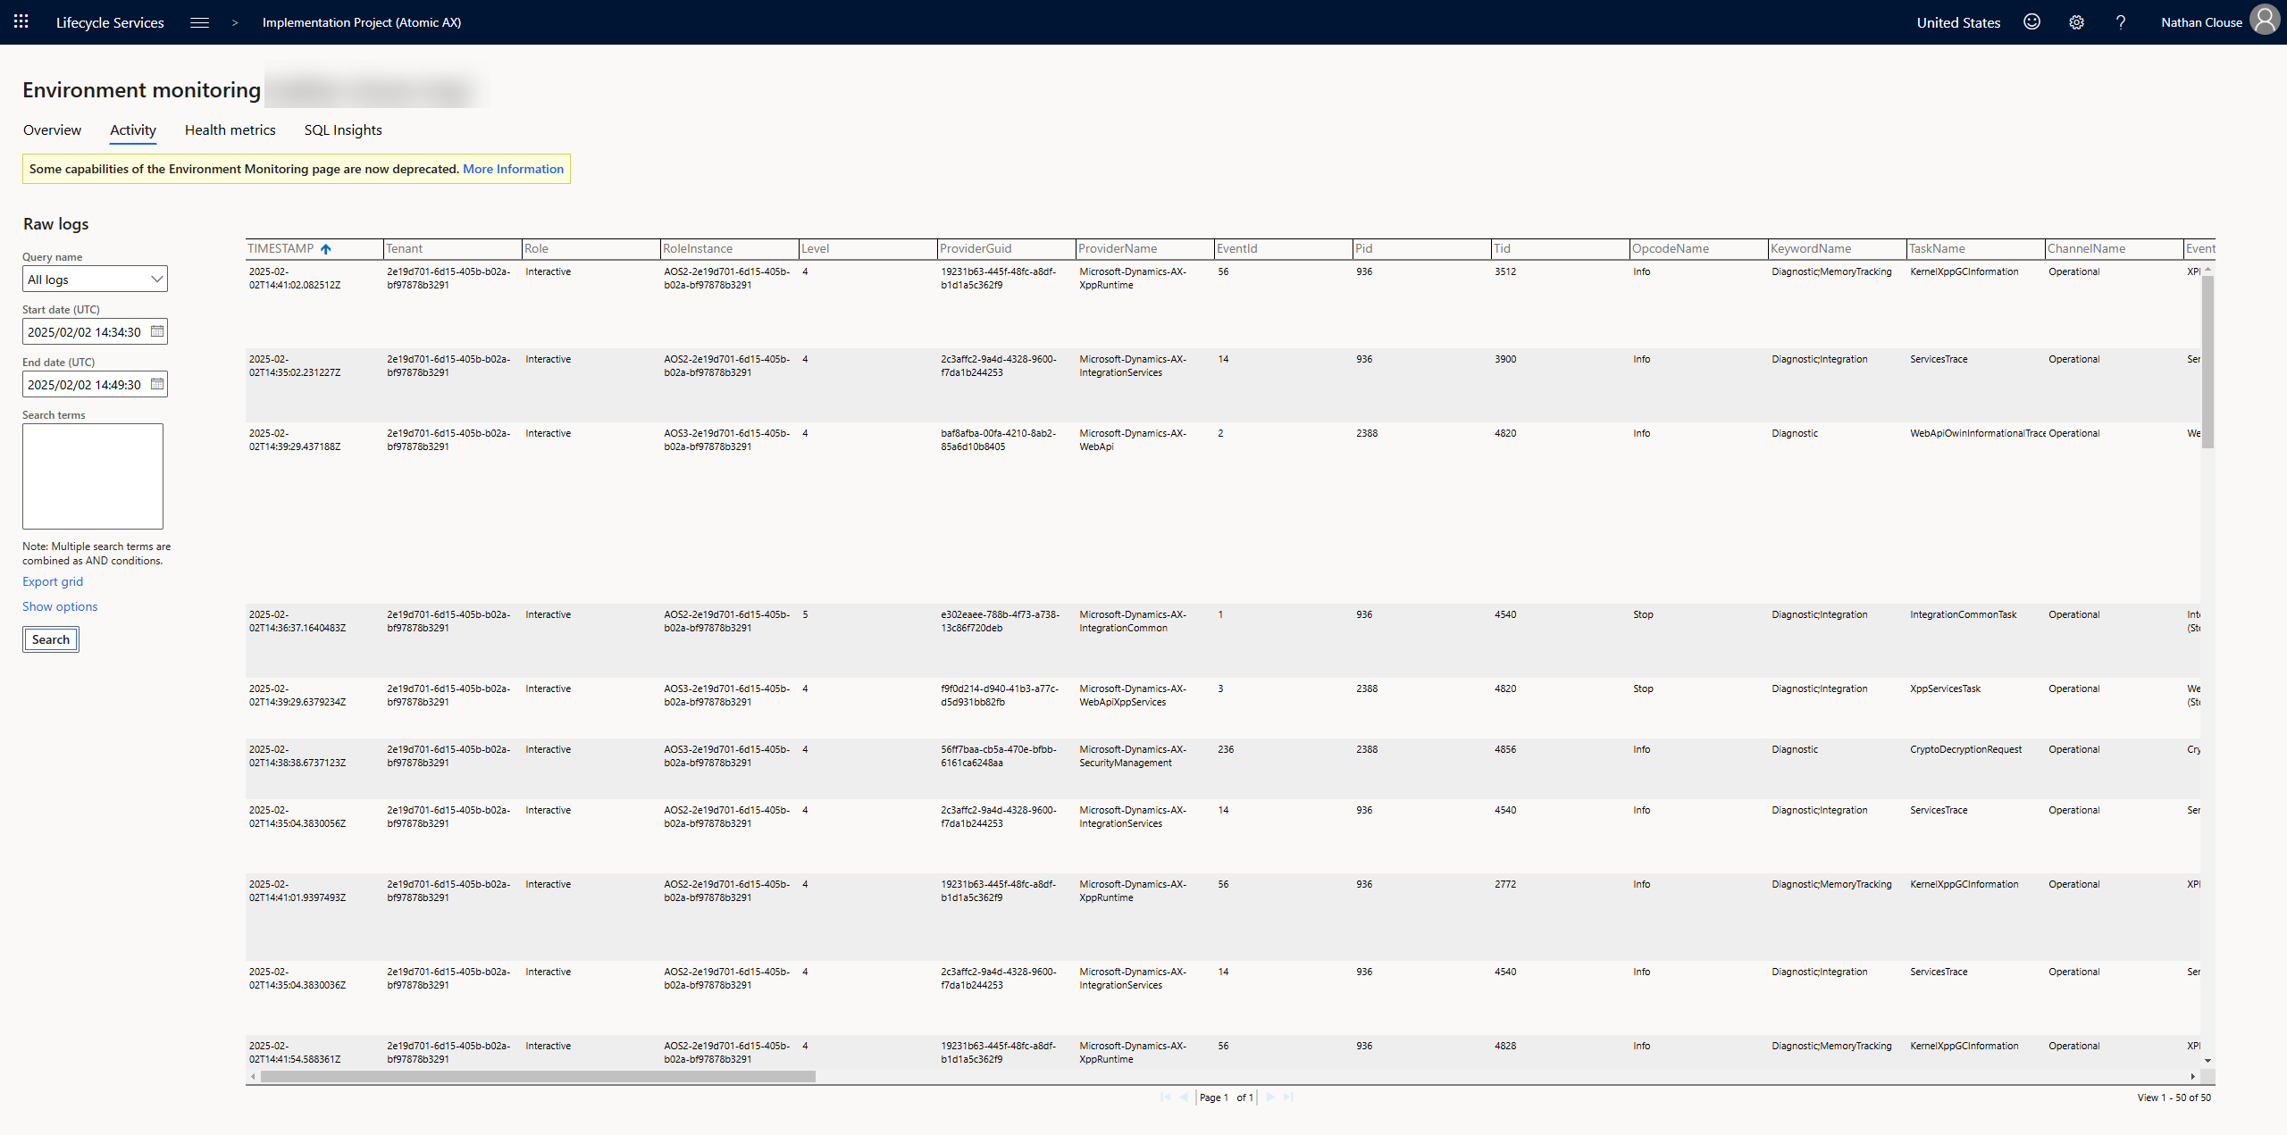

Slide 52
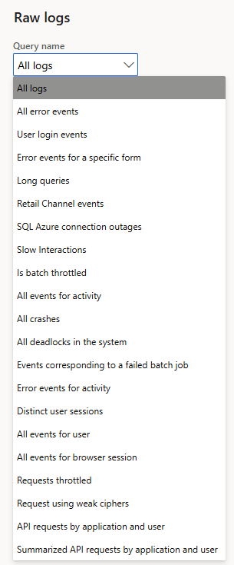
LCS

Slide 53
Tweak
Use Cleanup Batch jobs
Go to module > expand all > search for “Cleanup” or “clean”
Also check out Process Automation
Similar to Batch Jobs
Auto register and schedule based on code rules

Slide 54
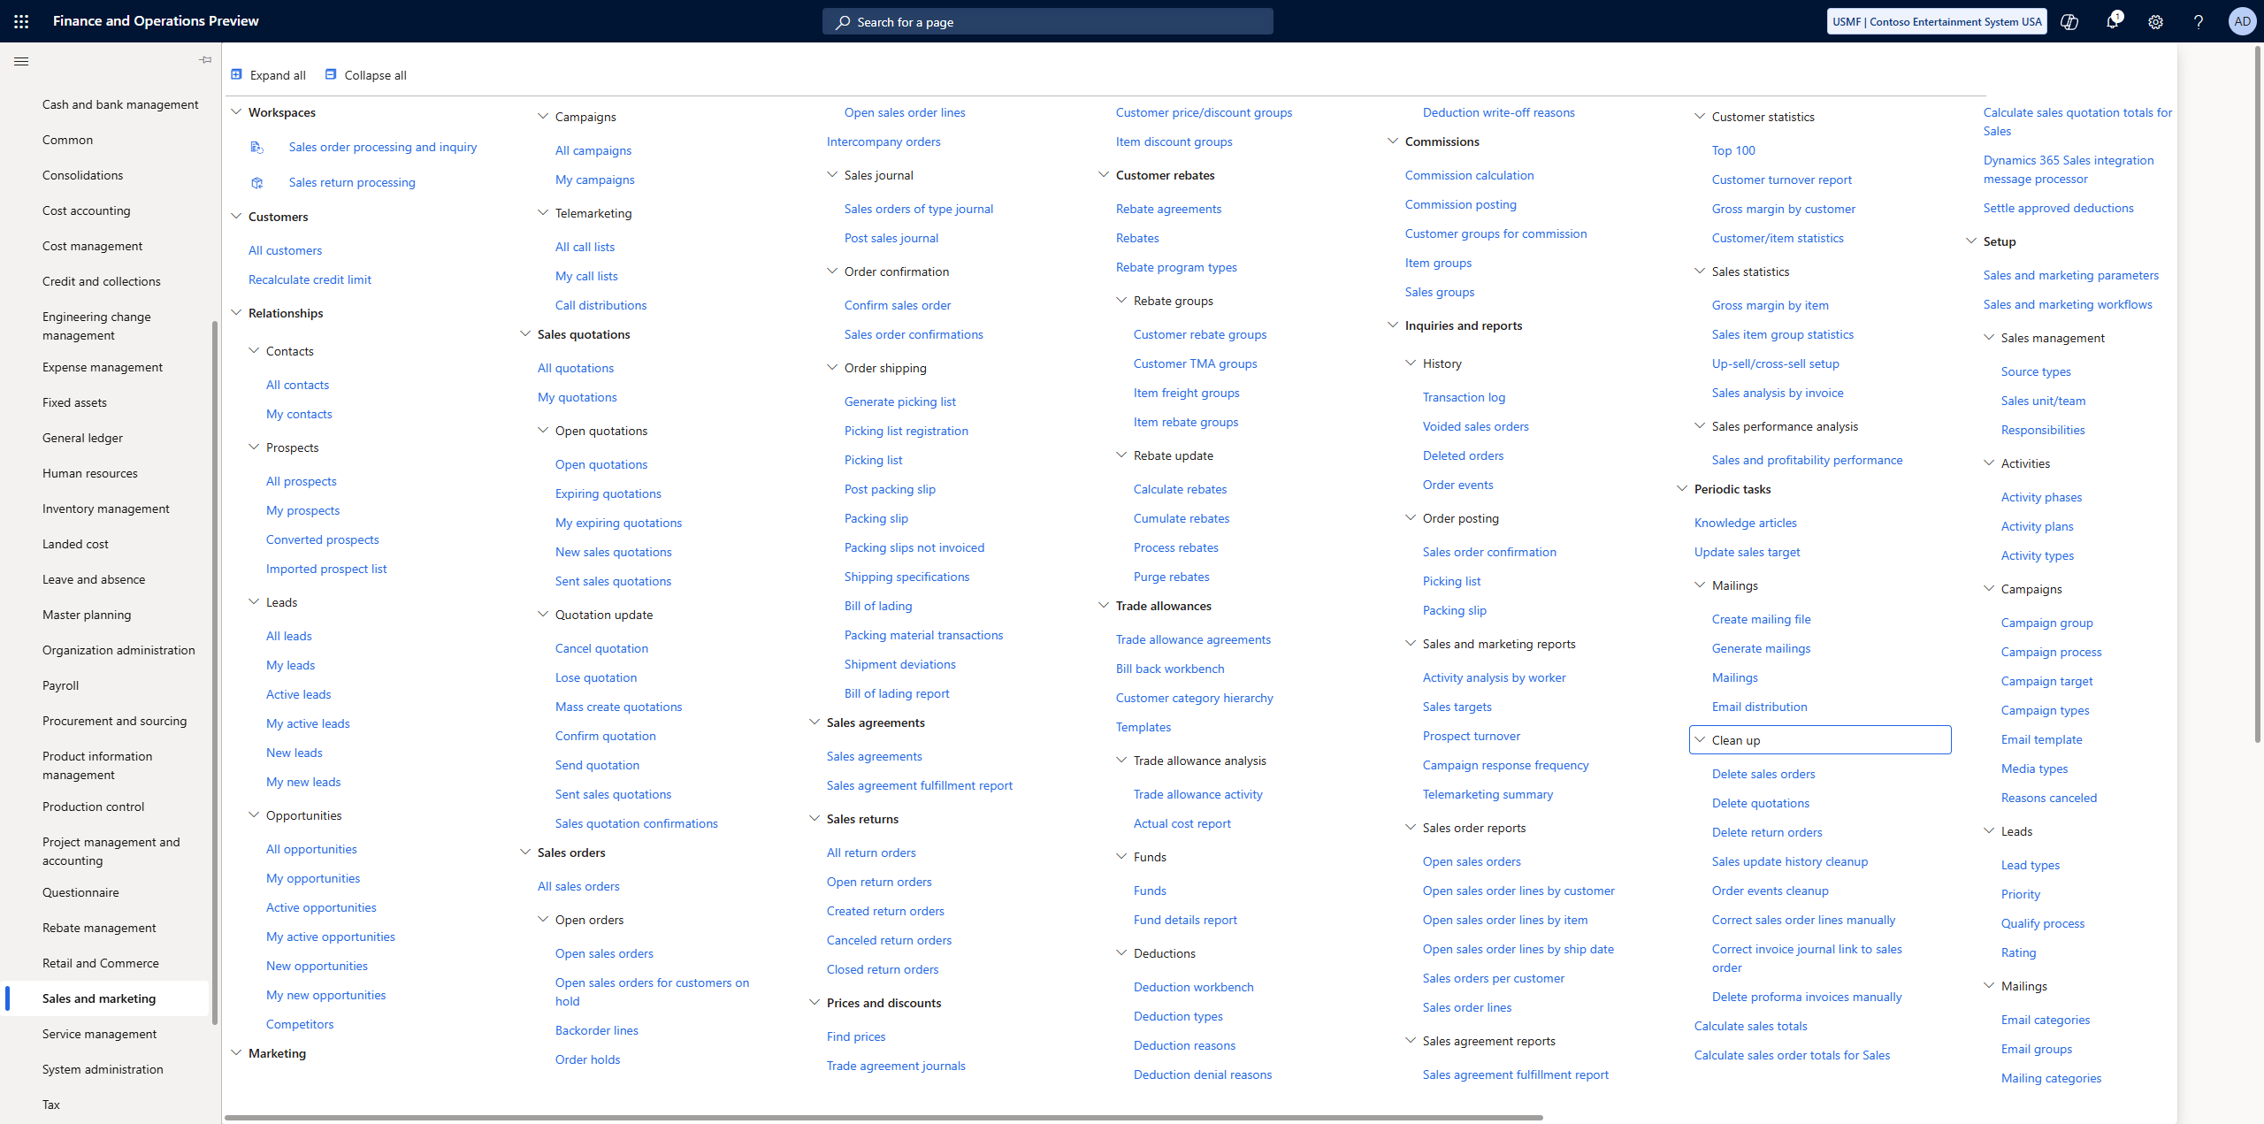

Slide 56
Summary
Use Set operations rather than row operators when you can
Understand the constructs used for data manipulations
Use Trace Parser to get detailed log data on performance issues
Identify database or code ( or both ) issues using tools like LCS and Trace Parser
Use Telemetry to monitor

Slide 57
References
https://community.dynamics.com/blogs/post/?postid=77bd7a1b-5cc7-4947-a724-109d41d113b3
https://community.dynamics.com/blogs/post/?postid=fc6c120d-b134-47ef-9651-b4deb7d3560c
https://ariste.info/2021/06/socratex-application-checker/
https://community.dynamics.com/blogs/post/?postid=b8014884-9aa3-4fdb-8e2a-b3440d01a79a
https://alexdmeyer.com/2023/10/03/using-telemetry-data-for-read-auditing-in-d365fo/
https://github.com/microsoft/Dynamics-365-FastTrack-FSCM-Telemetry-Samples

Slide 58
References
https://www.atomicax.com/article/does-specifying-columns-select-statements-matter
https://www.atomicax.com/article/database-inserts-and-performance
https://www.atomicax.com/content/odata-experiment-deep-dive-odata-and-how-use-it
https://www.atomicax.com/article/when-create-runbasebatch-batch-job
https://www.atomicax.com/article/when-create-individual-task-modelled-batch-job

Slide 59
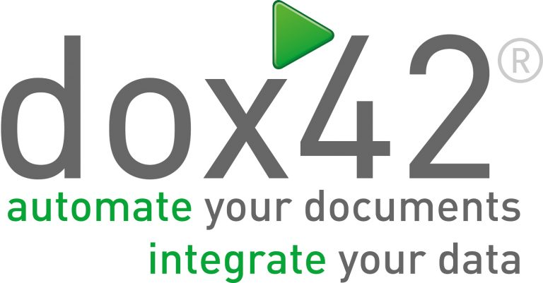



Sponsors
THANK
YOU!

